Slide 1
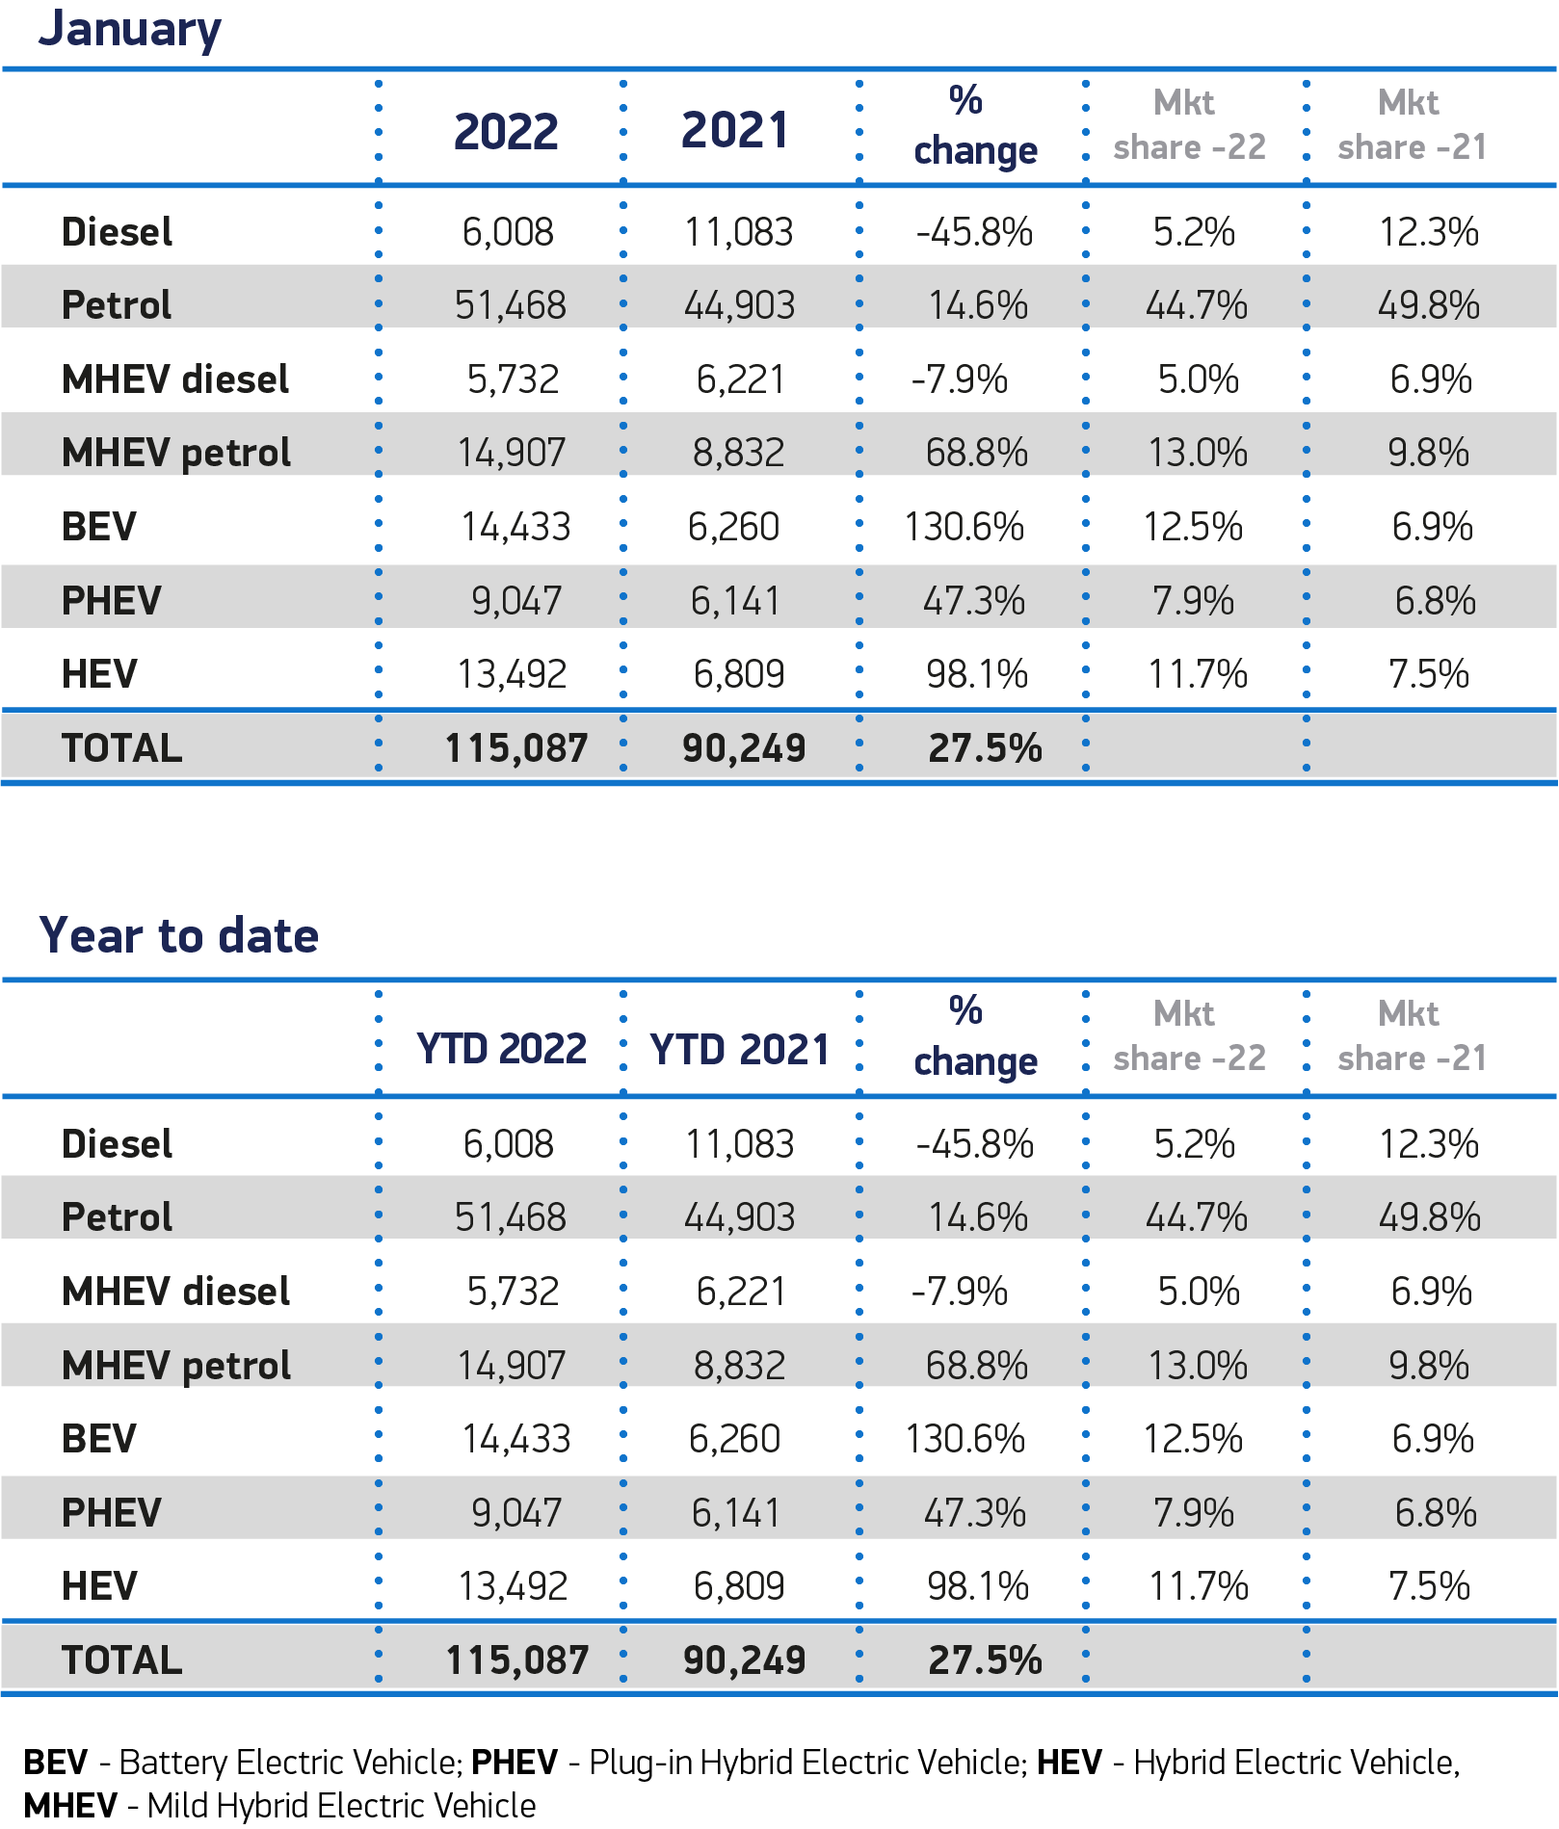
UK’s Car Registration in Jan 2022
Reference: https://www.smmt.co.uk/vehicle-data/car-registrations/

